Slide 1



CS5200
DATABASE THEORY AND APPLICATIONS
TITLE :
SMART SOCCER CLUB OPERATIONS PLATFORM
PROJECT REPORT

Slide 2


TEAM MEMBERS
LNU RUMANA THASKEEN 700742859 - TEAM LEADER
Aishwarya pasumarthy 700759282
Vivek reddy nakkala 700762302
Vamshi Kalyan Thummala 700766446
sai giridhar jittaboini 700761988
Nekkalapu Manesh 700756918

Slide 3
OBJECTIVE
In designing the database for the soccer system, a key objective is to fully exploit MongoDB's flexible, schema-less nature to accommodate ongoing changes and additions to the system without major disruptions.
This involves creating dynamic and adaptable data models for various entities such as Players, Teams, and Match Schedules, ensuring that new fields and statistics can be easily integrated as the application's needs evolve. Additionally, leveraging MongoDB's powerful aggregation framework and robust indexing capabilities will be crucial.
These features will enable complex, efficient queries that support detailed performance analysis, match outcome summarization, and tailored scheduling, all while maintaining high performance and scalability as the system grows. This approach not only facilitates immediate operational needs but also ensures the database architecture remains robust and responsive to future expansions and enhancements.

Slide 4
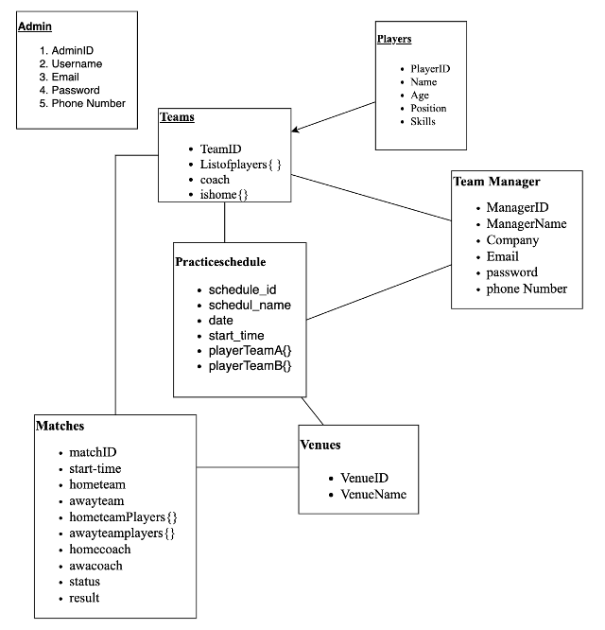
DATABASE DESIGN/SCHEMA

Slide 5


DATABASE COMPLEXITY
Our soccer system has different collection, Admin, Players, Team Manager, Teams, Practice Schedule, Matches, and Venues, each with their own set of attributes.
MongoDB's flexible schema would allow each of these entities to be stored as documents that can be easily modified as the application grows and requirements change. For instance, player profiles can be enriched with additional statistics over time, or the Practice Schedule might need new fields to accommodate different types of events.
The NoSQL nature of MongoDB means that you aren't locked into a rigid schema, giving developers the freedom to adapt the data model as new features are added to the system.
Additionally, MongoDB's powerful querying capabilities, including its aggregation framework, would enable complex queries across these documents, such as generating schedules, summarizing match outcomes, and analyzing player performance.

Slide 6
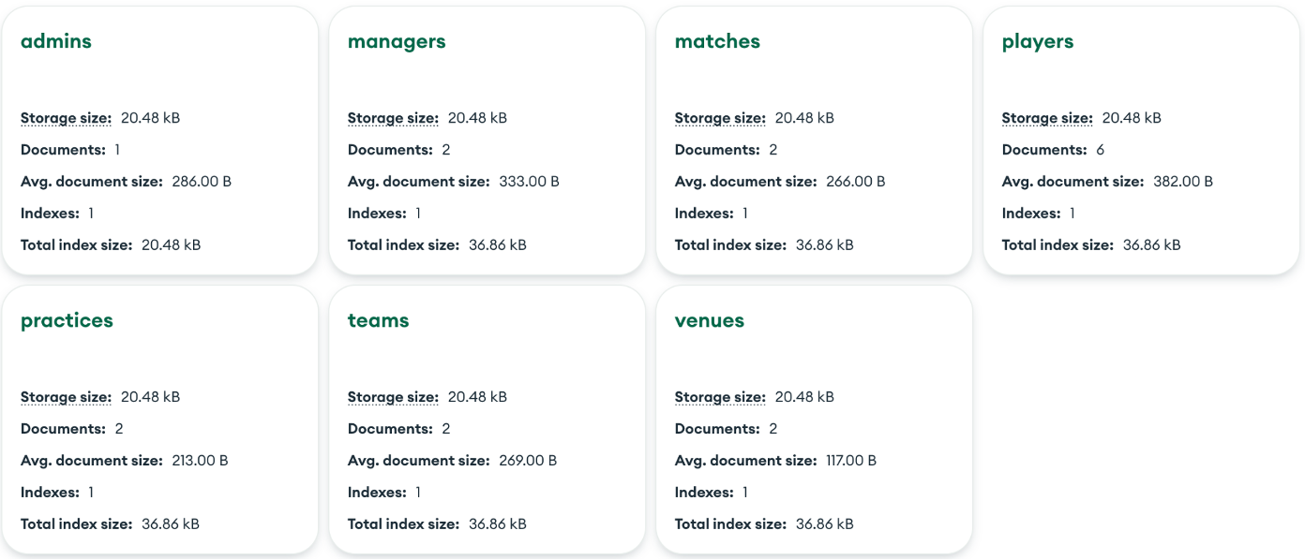

Slide 7
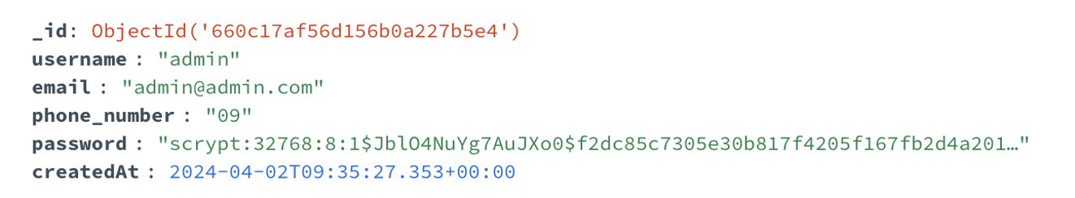
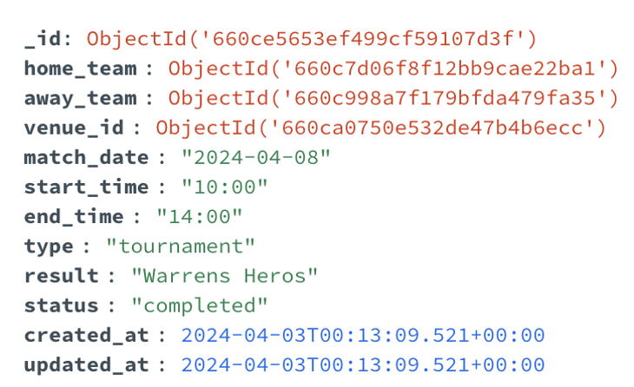
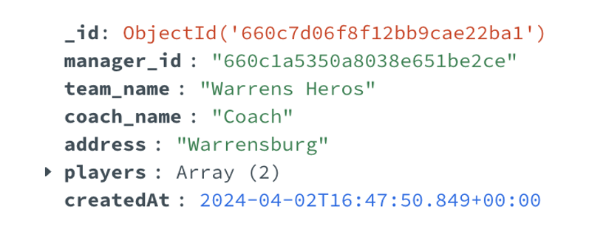

Slide 8
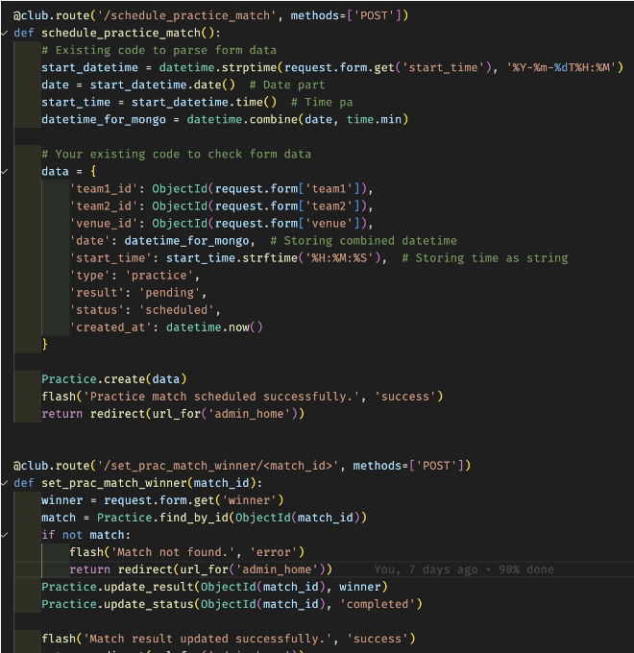
BACKEND CODE AND IMPLEMENTATION
Flask Efficiency: Our team can exploit Flask's modular nature to ensure a clean and maintainable codebase for our soccer management system. This streamlined approach simplifies the integration of new features, like match scheduling or player transfers, while maintaining a robust backend structure.
Developer Support: We benefit from Flask's extensive community and wealth of documentation, which facilitates quick troubleshooting and feature implementation. The support from fellow developers and access to a plethora of third-party extensions can significantly accelerate our development process.

Slide 9
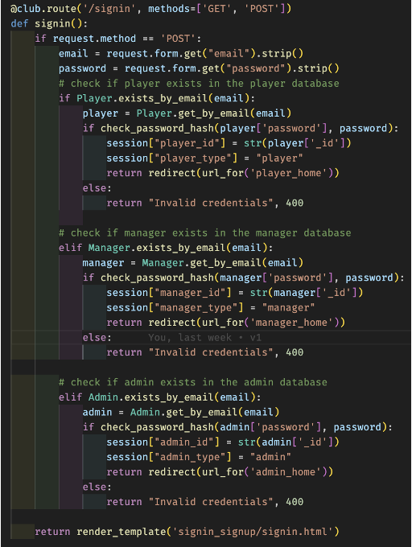
BACKEND CODE AND IMPLEMENTATION
Open Source Nature: The open-source aspect of Flask aligns perfectly with our soccer management system, allowing for customization at every turn. This gives us the flexibility to tailor the application precisely to our operational requirements without being constrained by proprietary software limitations.
Python Dynamics: Our system leverages Python’s dynamic typing and powerful libraries within the Flask framework. This enables us to develop complex features, like statistical analysis of player performance and match outcome predictions, with shorter and more readable code.

Slide 10
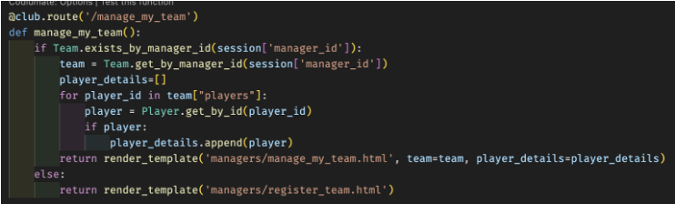
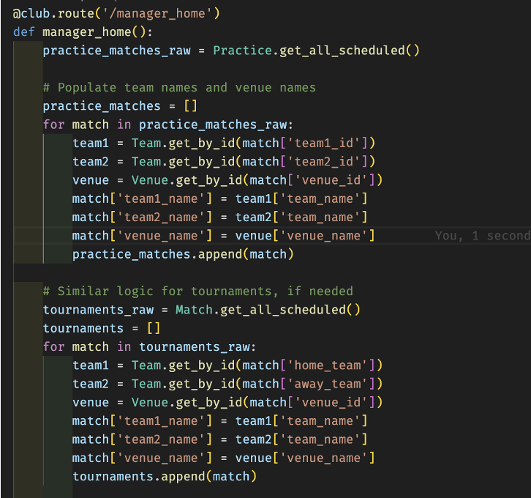
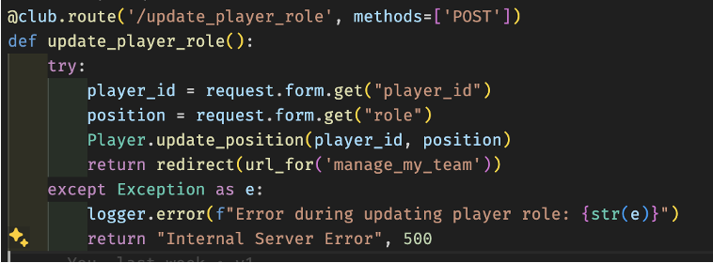
Cont..

Slide 11

FRONTEND CODE AND IMPLEMENTATION
For our soccer management application, we embraced a strategic approach to frontend development:
● HTML and CSS: These foundational technologies were applied to construct and style the user interface, with a particular emphasis on achieving a user-friendly layout that fans, players, and managers would find engaging and straightforward to navigate.
● Interactive JavaScript: We utilized JavaScript to breathe life into the frontend, implementing interactive features such as real-time match score updates, player statistics tracking, and animated visualizations of team standings.
● Bootstrap Integration: By incorporating Bootstrap, we ensured our application was not only quick to develop but also fully responsive, providing a seamless experience on both desktop and mobile devices, critical for users accessing the platform from the sidelines, stands, or on the go.
● Focus on Usability: In designing the interface, we concentrated on creating an intuitive and accessible experience, streamlining the navigation to allow users to easily manage teams, view schedules, and track league progress with minimal effort.

Slide 12
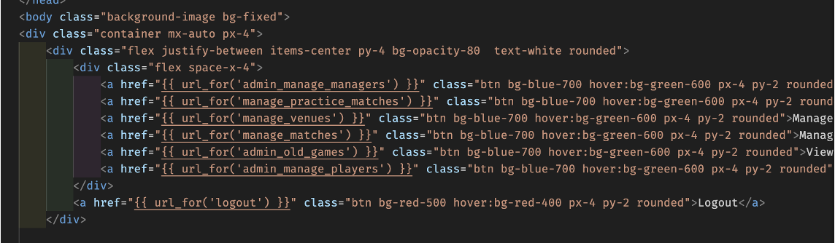
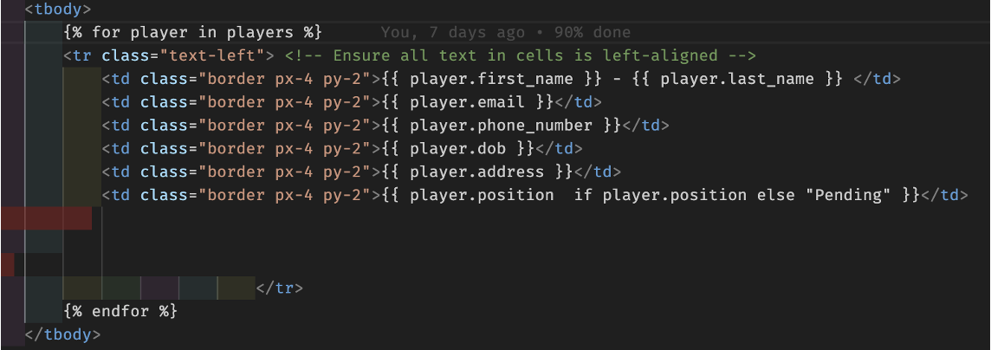

Slide 13
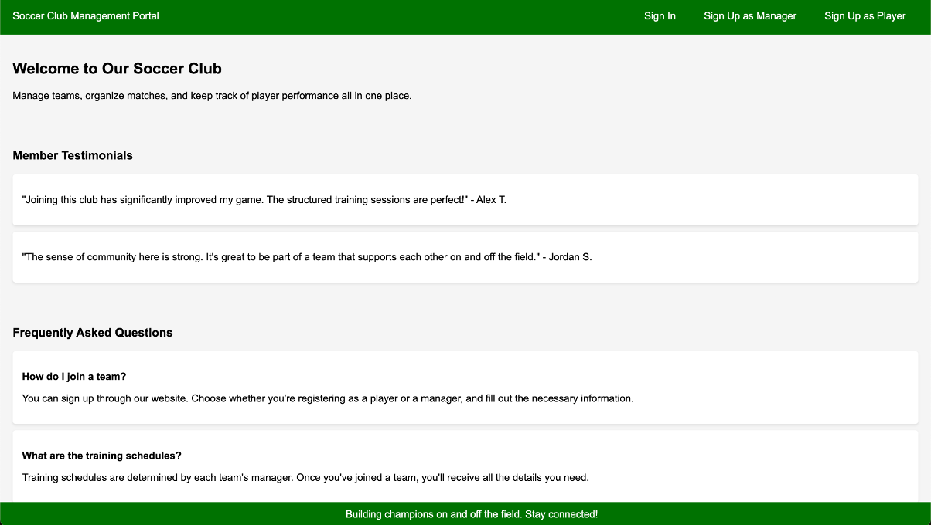
UI DESIGNS/APPLICATION SCREENSHOTS

Slide 14
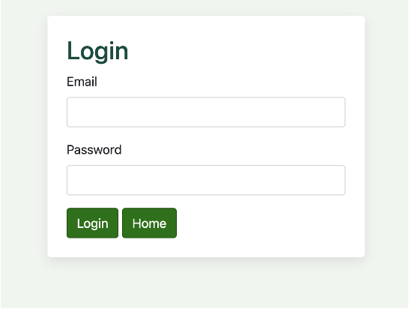
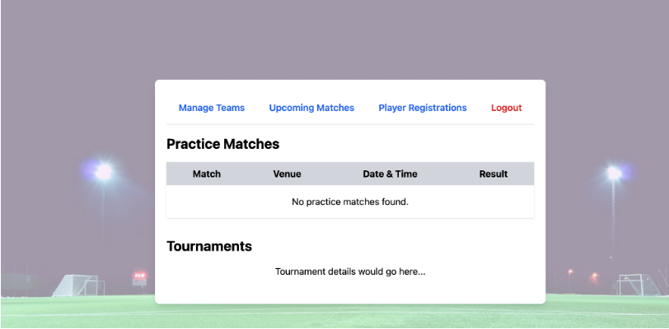
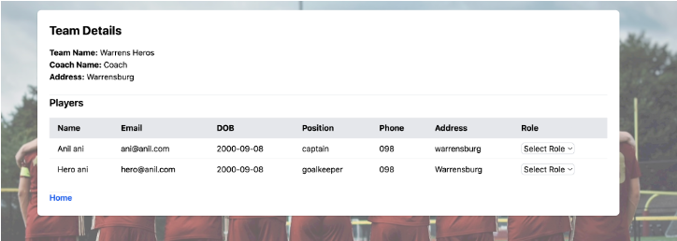
UI DESIGNS/APPLICATION SCREENSHOTS

Slide 15
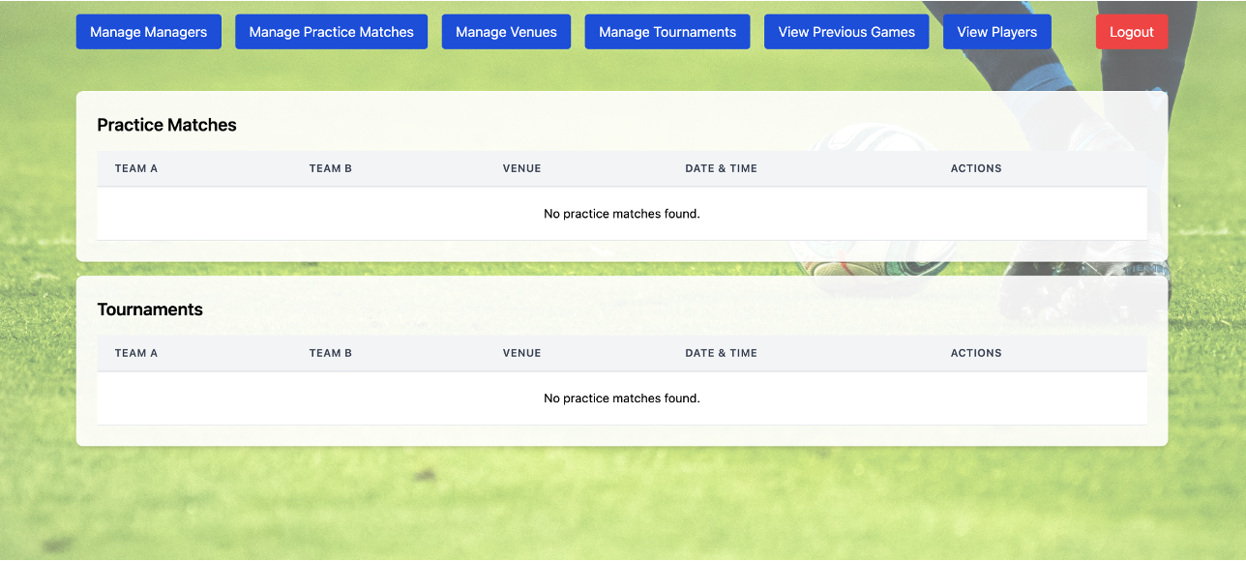
UI DESIGNS/APPLICATION SCREENSHOTS

Slide 16
FRONTEND EFFORTS
Aishwarya:
● Tailwind CSS Virtuoso: Aishwarya leveraged the utility-first approach of Tailwind CSS to craft a custom and responsive design. Her ability to blend aesthetics with function using Tailwind has resulted in a unique and cohesive visual identity for our soccer management system.
● Unsplash Curator: She selectively sourced high-quality, open-source imagery from Unsplash to bring authentic and vibrant visuals to our platform, which resonate with the energy and passion of the soccer community.
● User Engagement Designer: Aishwarya focused on creating an immersive user experience by ensuring that the layout is intuitive and the content is engaging, utilizing Tailwind CSS to implement design elements that are both functional and appealing.
● Accessibility Champion: Emphasizing inclusivity, Aishwarya has ensured that all design elements meet accessibility standards, allowing a broader audience to interact effortlessly with our platform.

Slide 17
FRONTEND EFFORTS
Vivek:
●Dynamic Interaction Architect: Vivek has implemented interactive elements that respond to user actions, like team selections and live match updates, using JavaScript alongside the Tailwind CSS framework to create a fluid and responsive user experience.
●Performance Tuner: He has meticulously refined the front-end performance, ensuring that the Tailwind CSS-based designs are optimized for speed and efficiency, crucial for the real-time data updates in our soccer management application.
●Tailwind CSS Strategist: Vivek's strategic use of Tailwind CSS has facilitated rapid development of a mobile-first interface, ensuring our platform's design is adaptable and consistent across all devices.
●Open-Source Advocate: His commitment to open-source solutions extends beyond using Tailwind CSS; he's integrated open-source imagery and icons that enhance the visual appeal without the overhead of proprietary licenses.

Slide 18
BACKEND EFFORTS
Vamshi:
●Database Architect: Vamshi has been pivotal in designing the database schema and optimizing queries in MongoDB, ensuring that data retrieval is both swift and reliable, which is essential for real-time updates during live matches.
●API Craftsmanship: His development of RESTful APIs allows for seamless interaction between the frontend and backend, ensuring data consistency and integrity throughout the soccer management system.
●Load Management Expert: Recognizing the potential for high traffic, Vamshi has implemented efficient caching and load balancing solutions that help maintain the application's performance during peak times, such as during popular matches or tournaments.
●Security Implementer: He has fortified our platform against vulnerabilities by instituting robust security measures, including secure authentication and data encryption, safeguarding user data and system integrity.

Slide 19
BACKEND EFFORTS
Giridhar:
●Asynchronous Processing Innovator: Giridhar has integrated Python's async features to manage concurrent tasks efficiently, such as handling multiple user requests for team updates or match results simultaneously.
●Scalability Architect: He has engineered our backend services with scalability in mind, utilizing Flask’s ability to expand and contract resource utilization in sync with our user base and traffic patterns.
●Performance Monitoring: Giridhar has set up a comprehensive monitoring system that tracks performance metrics and automatically adjusts resources to meet demand, ensuring that the system remains responsive at all times.
●Continuous Integration/Continuous Deployment (CI/CD) Proponent:
His implementation of CI/CD pipelines has streamlined our development process, enabling quick and reliable updates to the platform, which is key for introducing new features and responding to the ever-evolving needs of our users.

Slide 20

DATABASE EFFORTS
Manesh:
●Data Integrity Guardian: Manesh has established rigorous protocols to maintain the accuracy and consistency of our data across the platform, which is crucial for the real-time statistics and leaderboards that our soccer management system features.
●Performance Tuner: He has optimized database performance through careful indexing and query optimization, ensuring that even complex match statistics and player data are retrieved without delay.
●Backup and Recovery Planner: Understanding the value of our data, Manesh has implemented a comprehensive backup strategy that ensures we can quickly recover from any data loss event, keeping our platform's valuable data secure.
●Scalability Enforcer: With foresight into our platform's growth, Manesh has designed a scalable database infrastructure that can handle an expanding user base and increasingly large data sets without performance degradation.

Slide 21
DATABASE EFFORTS
Rumana:
● Security Strategist: Rumana has taken the lead in fortifying our database against external and internal threats, implementing layers of security measures including encryption, access controls, and auditing to protect sensitive user and operational data.
● Data Accessibility Specialist: She has streamlined data access patterns to facilitate quick and efficient data retrieval, which enhances user experience by providing instantaneous access to schedules, player stats, and match outcomes.
● Disaster Recovery Expert: Rumana has set up robust disaster recovery systems that ensure our platform can withstand and swiftly recover from any disruptions, keeping our service available and reliable at all times.
● Data Policy Advocate: She promotes best practices in data handling and storage, ensuring compliance with legal standards and data protection laws, thus preserving the trust of our users and stakeholders in our soccer management system.

Slide 22
APPLICATION URL
HTTPS://SOCCER-CLUB-ZZ2K.ONRENDER.COM/

Slide 23

THANK YOU

